Slide 1
EventsHQ
Virtual Event Registration
Marketing Communications Office \ updated November 2020

Slide 2
Part 1: What the User Sees
Virtual Event Details & Join the Event link

Slide 3
Virtual Registration – User View
Thanks for choosing EventsHQ for your virtual event. If you are using EventsHQ for your registration and confirmation, there are a few options to consider for how you share your virtual event access link (whether that is BlueJeans, Zoom, YouTube, etc) with your audience.
OPTION 1 EventsHQ Custom Virtual Platform Access (Recommended) - Virtual platform link entered in Events HQ Virtual Details - Link remains private until event day using Join the Event dynamic link - Link accessible only to registered attendees.
OPTION 2 Directly share virtual platform link -Include your access link on your Event Page or in your communication piece

Slide 4
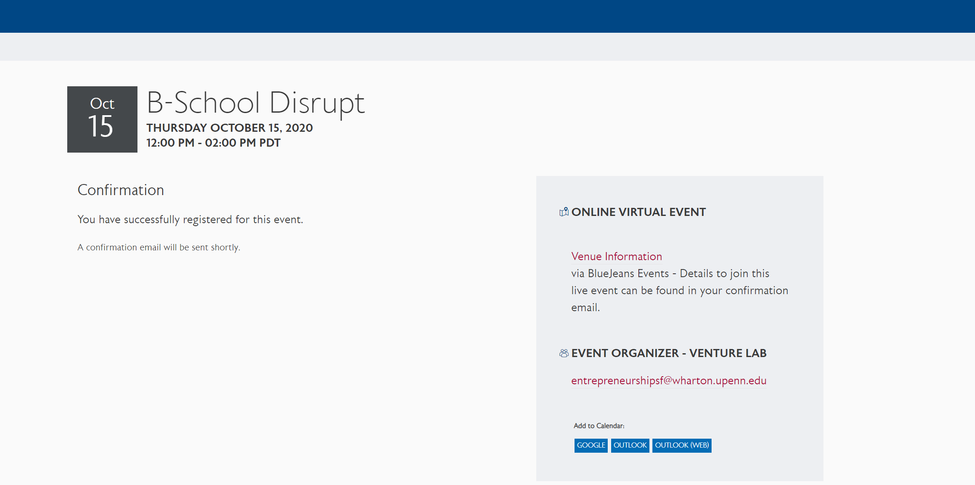
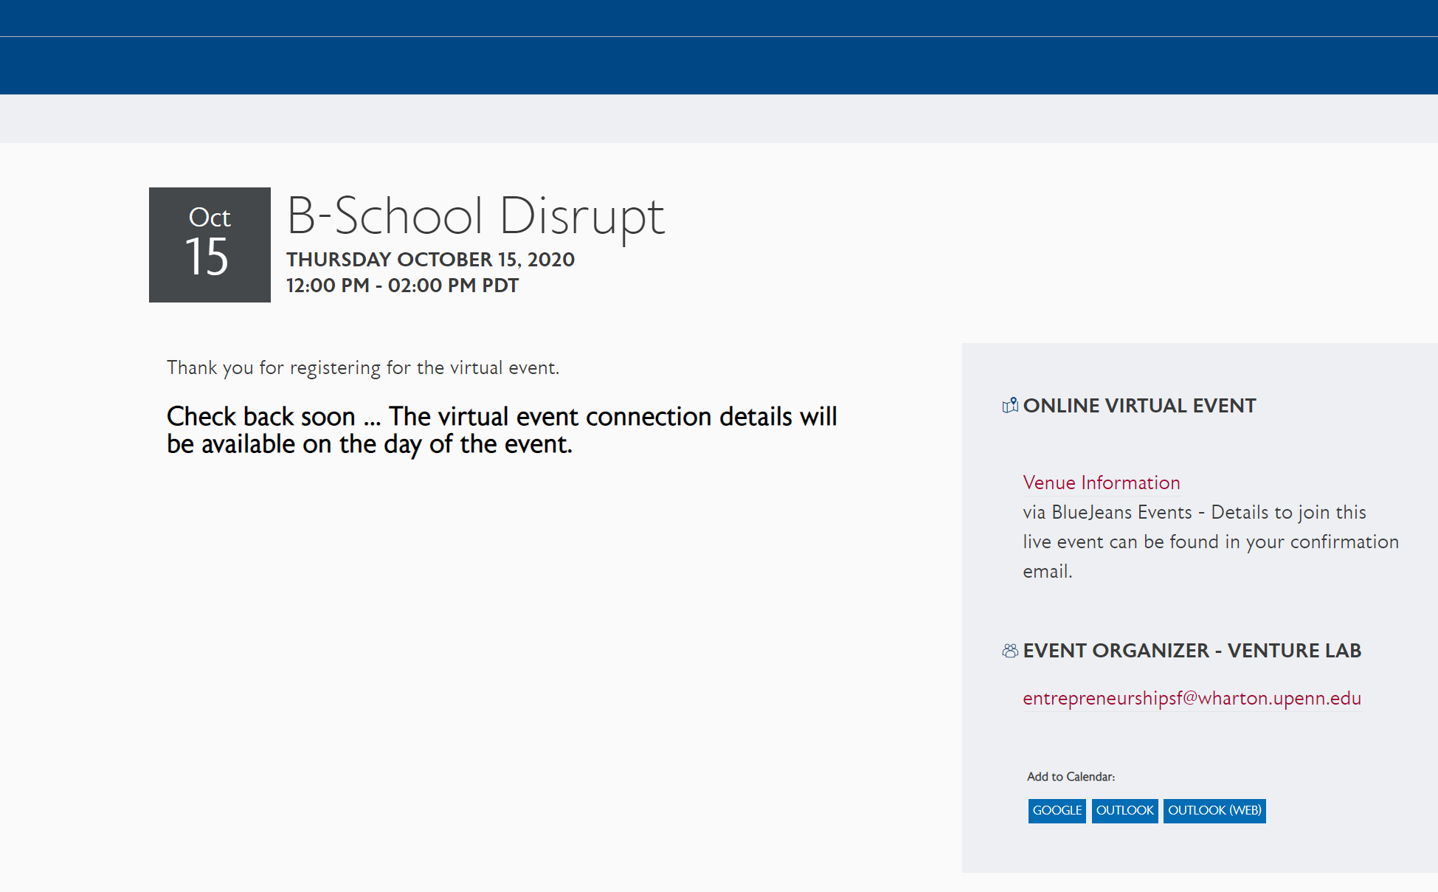
Virtual Registration – User View
When using the Virtual Event Details feature of EventsHQ, your link is hidden until your event day (at midnight). So the user sees the following:
At Confirmation
Message confirms registration. Link sent via confirmation
After Confirmation
Holding message displays until midnight event date with user clicks Join the Event link

Slide 5
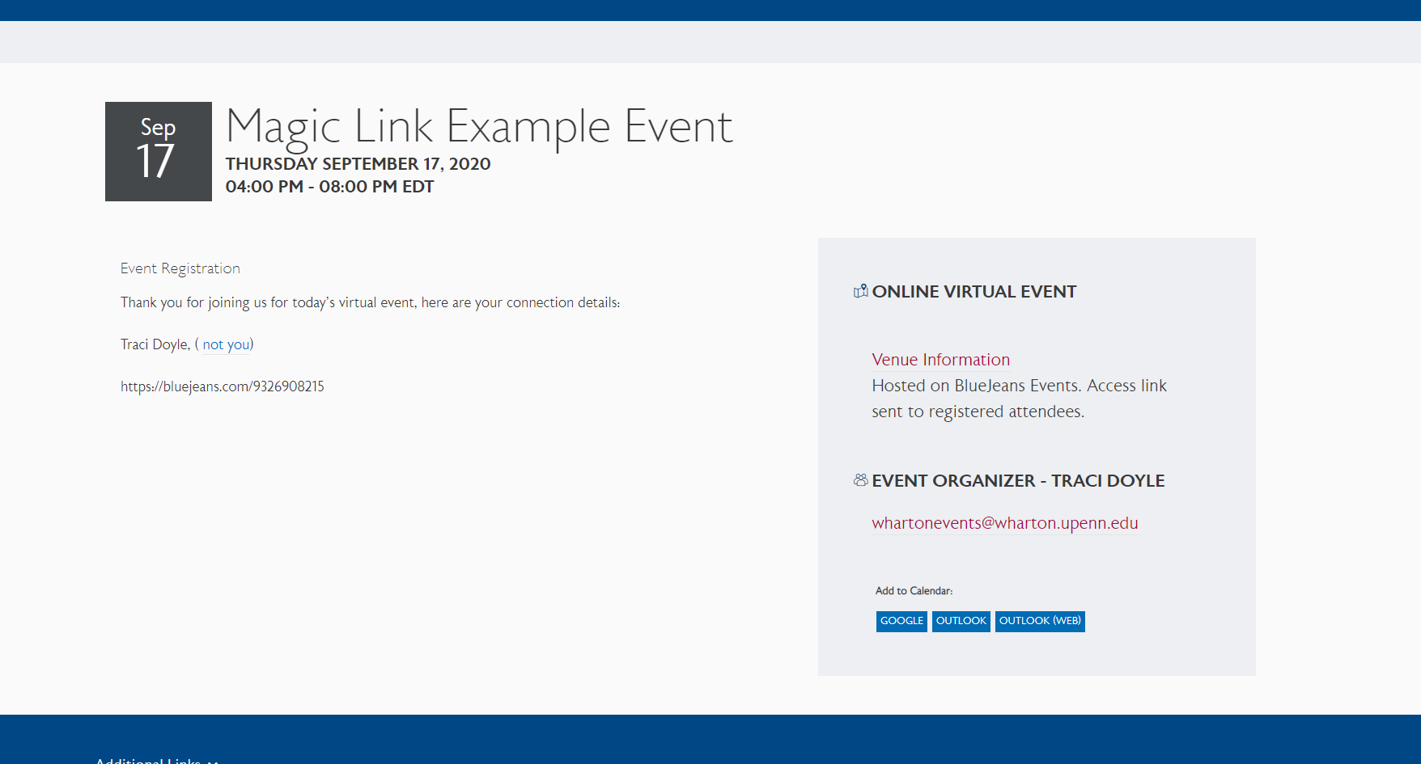
Virtual Registration – User View
EVENT DAY On the day of the event, the user clicks the Join the Event button from your email confirmation. The access information from the EventsHQ Virtual Details section appears
Best practice:
Send a 30 minute Reminder/Event is Live Email with the Join the Event Link
Hyperlink your virtual access link when entering in EventsHQ

Slide 6
Part 2: Set Up
How to set up Virtual Registration in EventsHQ and Campaign Monitor

Slide 7
Events HQ – Attendee Virtual Access
Step 1: Add Link to EventsHQ
The link to view your virtual event should be entered in the Virtual Event Details section of EventsHQ
Add the virtual event link up to (1) day prior to your event - Great for if you have not determined your platform when the invite goes out, or last minute changes from Zoom Meetings to Zoom Webinar.
Virtual Event Details displayed only to registered users on the day of the event
The Join the Event code allows you to track your user from invite to event and manage who views your virtual event link

Slide 8
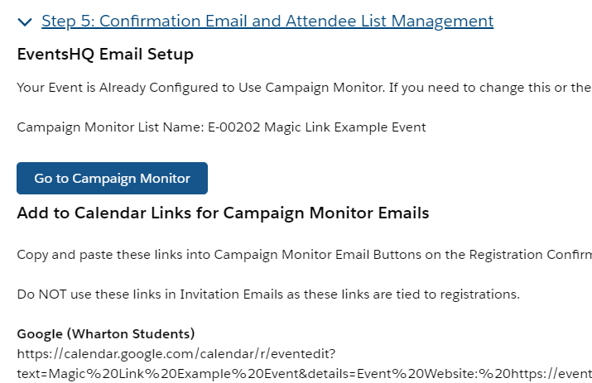
Events HQ – Attendee Virtual Access
Step 2: Enable Campaign Monitor in EventsHQ
EventsHQ
Creates a registration list in CM for your event
Campaign Monitor
View your CM Registration List

Slide 9
Virtual Registration – Attendee Virtual Access
Step 3: Set up Join the Event code in your attendee emails
To link your EventsHQ event, Campaign Monitor Registration and Virtual Access Details, use this code on any button/hyperlink where you ask registered attendees to View their Confirmation or Join the Event
..BUT WHY?
Simplify your event setup – code never changes! Just update your email templates for each Event
Keep your event link private
Ensure easy access to event link to reg. attendees
Send invite before platform established/change link if needed
Track users from invite through attendance
JOIN THE EVENT CODE
https://events.wharton.upenn.edu/events-hq/[EventId,fallback=]/join/?ticket-id=[RegistrationID,fallback=]
Event ID connects the EventsHQ page
Registration ID confirms the users registration
JOIN shares the private link & marks the user as attendee

Slide 10
Virtual Registration – Attendee Virtual Access
JOIN THE EVENT CODE – WHERE, WHY, HOW?
CONFIRMATION
REMINDER
EVENT IS LIVE
Enable Campaign Monitor during your EventsHQ setup – creates Registration List.
Create a confirmation journey to send to the Registration List.
Add a button in your confirmation email and enter the Join the Event code as the hyperlink
When registered user clicks, brings them to Event Confirmation page
Same code from confirmation
Schedule a Reminder email in Campaign Monitor
Sent to the registration list created through EventsHQ
When registered user clicks, brings them to Event Confirmation Page
Same code as confirmation, reminder email
Schedule an Event is Live email in Campaign Monitor
Email sent to the same registration list
When registered user clicks on the event day, brings them to page with Virtual Access Link visible

Slide 11
Virtual Registration – Attendee Virtual Access
EVENT DAY – MARKED AS ATTENDANCE
After your event, users who clicked the Join the Event button are automatically marked as attendance in you EventsHQ registration
This means you can track:
Who was sent invite
Who opened/clicked/registered for invite
Who attended the event

Slide 12
Part 3: Communicating with Attendees
How to share your virtual access information with attendees

Slide 13
Virtual Events - Communications
There are a number of key details that need to be shared with your audience for virtual events. We created a series of Campaign Monitor templates to help streamline this process.
7-10 DAYS OUT
INVITE
AUTOMATE
CONFIM
1-2 DAYS OUT
REMIND
30 MINUTES
JOIN NOW

Slide 14
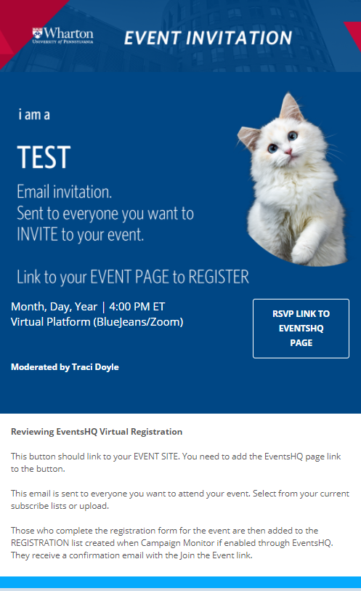
Virtual Event Communication Pieces
Invitation
Basic information about your event
Links to Events HQ Page for registration
Avoid “tech” details on this piece such as event access details
– save that for confirmation

Slide 15
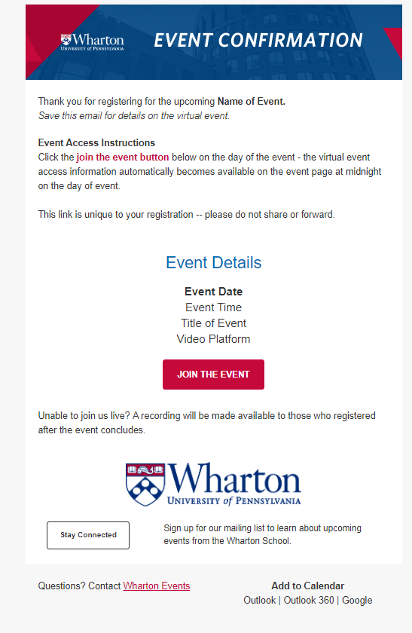
Virtual Event Communication Pieces
Confirmation
Sent to registered attendees
Enable Campaign Monitor when setting up EventsHQ to automatically create list in your CM account
Includes your instructions on HOW users will access the event
Use the Join the Event code – users can click the button to view the confirmation page prior to the event/view the event link on the event date
Create an automation through Campaign Monitor to send automatically.
For information on setting up an automation, see the Campaign Monitor Automation training

Slide 16
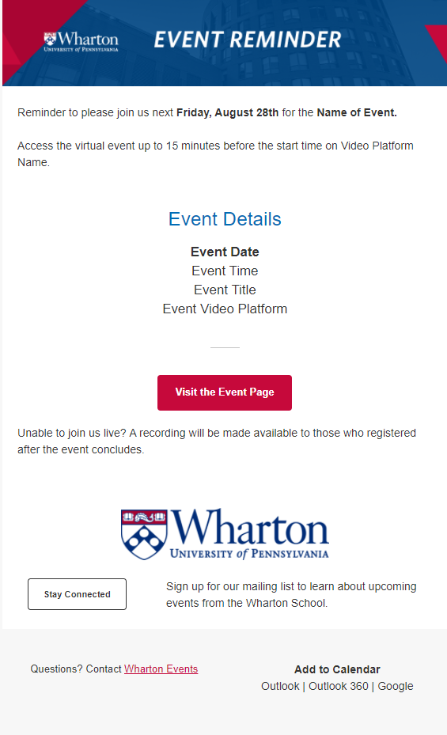
Virtual Event Communication Pieces
Reminder
Sent to registered attendees
Includes reminder instructions on HOW users will access the event
Use the Join the Event code – users can click the button to view the confirmation page prior to the event/view the event link on the event date
Schedule to go out to your registration list – recommendation is 7 days out and 1 day out for virtual events, based on when your original invite was sent

Slide 17
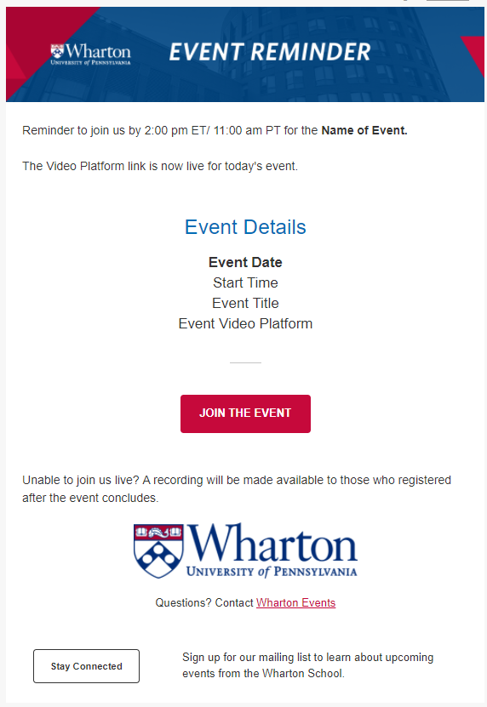
Virtual Event Communication Pieces
Event is Live
Sent to registered attendees the day of your event
Reminds them to join now
Use the Join the Event code – users can click the button and go directly to the EventsHQ link page
Schedule to go out to your registration list 30 minutes prior to your start time

Slide 18
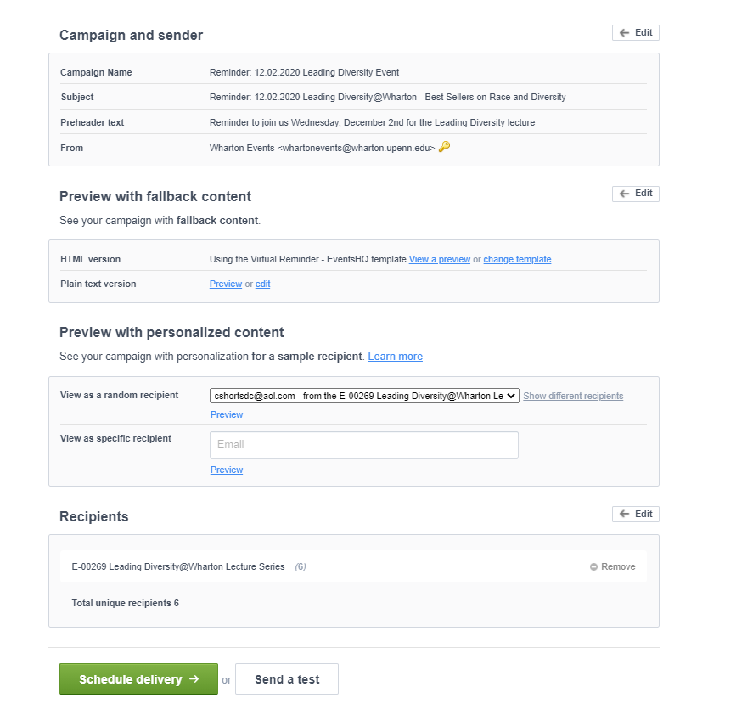
Previewing Confirmation/Reminder Links
To preview that the dynamic link is displaying correcting for your users, simply define your recipients (Select the list created by Events HQ, begins with E-) and select preview with dynamic content
DEFINE RECIPIENT
PREVIEW WITH PERSONALIZED CONTENT
Select Preview with personalized content, then click the Join the Event button on the preview email that appears.

