Slide 1
EventsHQ
Event Emails and Communications
Marketing Communications Office \ updated January 2021

Slide 2
Part 1: Event Communication - What the User Receives
Standard vs. Customizable Emails

Slide 3
Getting Started – Marketing your event
Congratulations on creating your Events HQ Event! There are a few options for how to marketing your event to your audience. First, let’s review the most common communication pieces needed
7-10 DAYS OUT
INVITE
AUTOMATE
CONFIM
1-2 DAYS OUT
REMIND
30 MINUTES
JOIN NOW

Slide 4
Getting Started – Communicating Event Details
Below are the recommended communication pieces for sharing event details with your audience using Campaign Monitor.
invitation
CONFIRMATION
REMINDER
EVENT IS LIVE
Scheduled Initial email goes to your broad target audience, includes your basic event details
Includes link to your Events HQ registration
In Campaign Monitor (CM), created under CAMPAIGNS tab using your preferred template
Automatic email sent when a users registered
Can select basic email through Events HQ or custom email created in CM
For virtual events, includes your access details or dynamic link
In CM, created through the AUTOMATION tab
Scheduled to go to registered users. Includes all the same info. From confirmation
Sent to the registration list created through EventsHQ
In CM, created under CAMPAIGNS tab using your preferred template
Scheduled to go to registered users the day of the event. Includes all the same info. From confirmation
Sent to the registration list created through EventsHQ
In CM, created under CAMPAIGNS tab using your preferred template

Slide 5
Getting Started – Selecting your Confirmation Method
There are two paths for sending confirmation emails using Events HQ – Standard Events HQ emails or customizable Campaign Monitor automated emails
Salesforce Automatic Confirmation Email (non-customizable)
Campaign Monitor Registration List and Confirmation Email (customizable)
Sends an automatic confirmation from Salesforce.
Email templates cannot be customized and come from a generic no-reply address.
This is the automatic default option that requires no configuration.
Creates an additional Registration Email list in CM.
Allows customization of confirmation email through Campaign Monitor templates with event-specific details, branding and logos.
Allows for easy follow up in CM with registered attendees
This is created via Campaign Monitor Automations

Slide 6
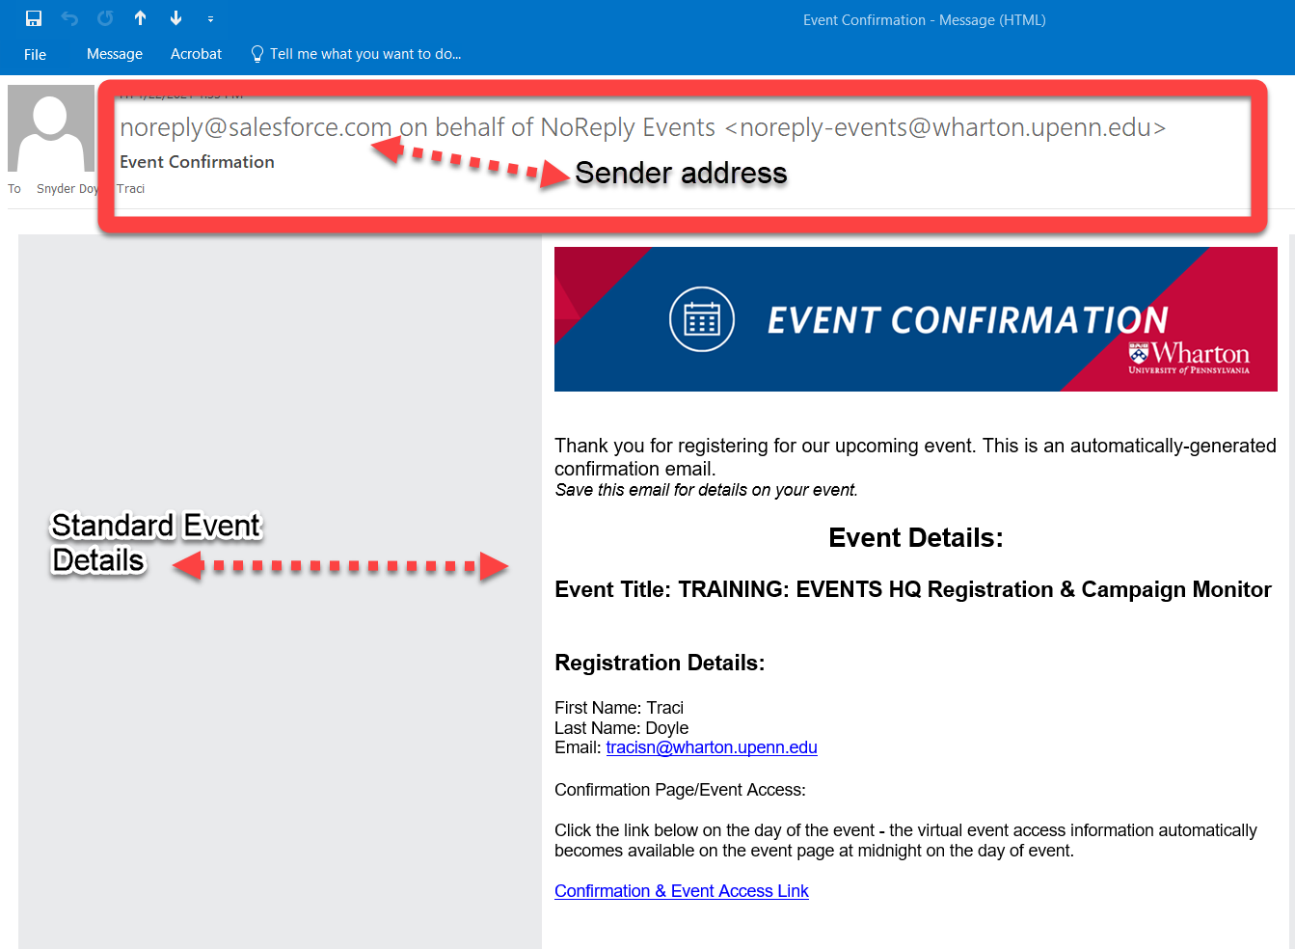
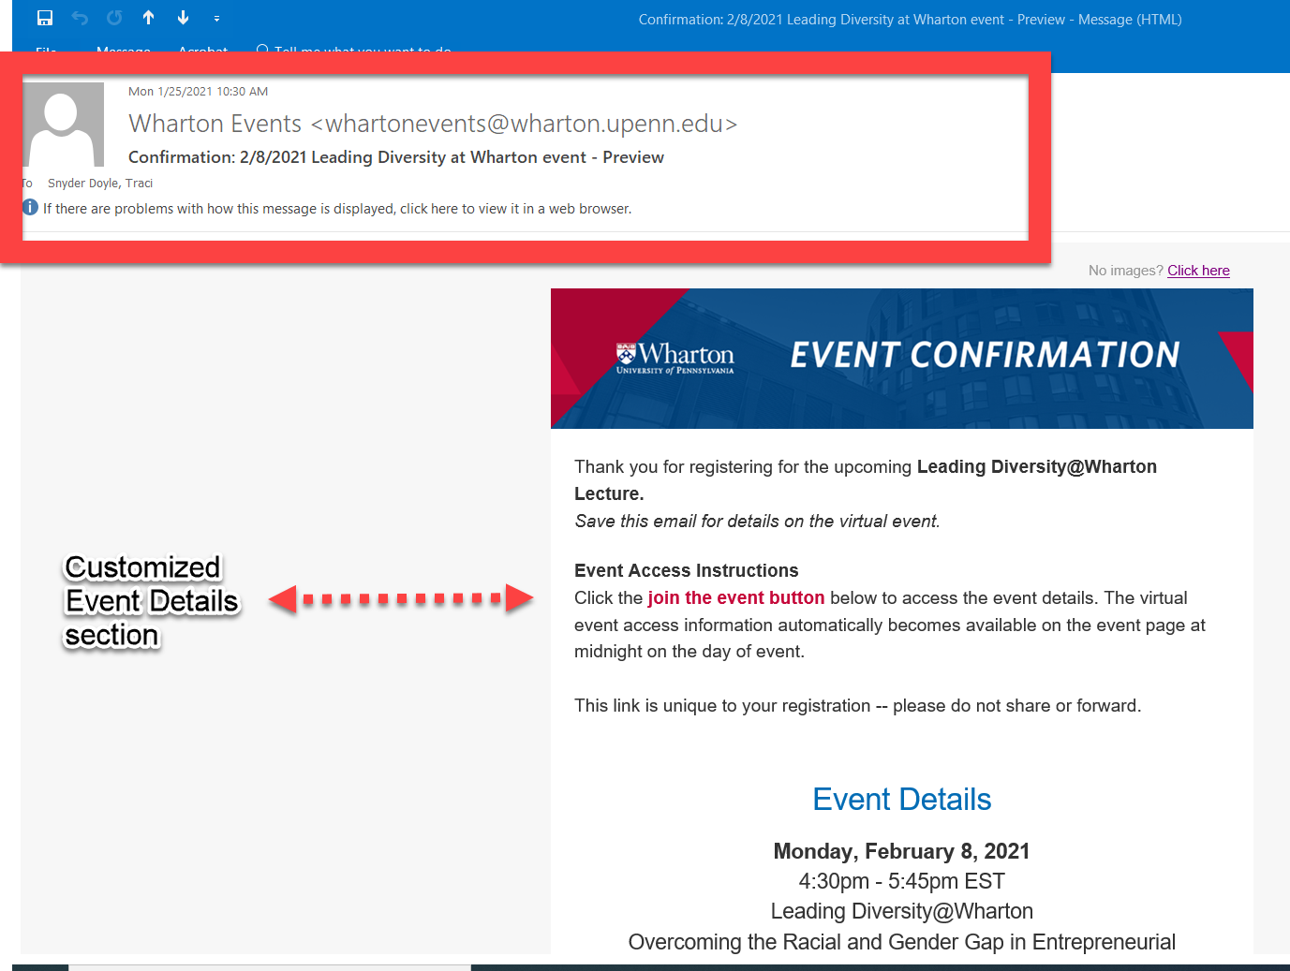
Getting Started – Selecting your Confirmation Method
Here are what the confirmation emails may look like based on your chosen path
Salesforce Automation
Campaign Monitor Confirmation

Slide 7
Enabling Salesforce Confirmation Email
Simple leave the Enable Campaign monitor check- box blank to automatically select the Salesforce Confirmation Email option.

Slide 8
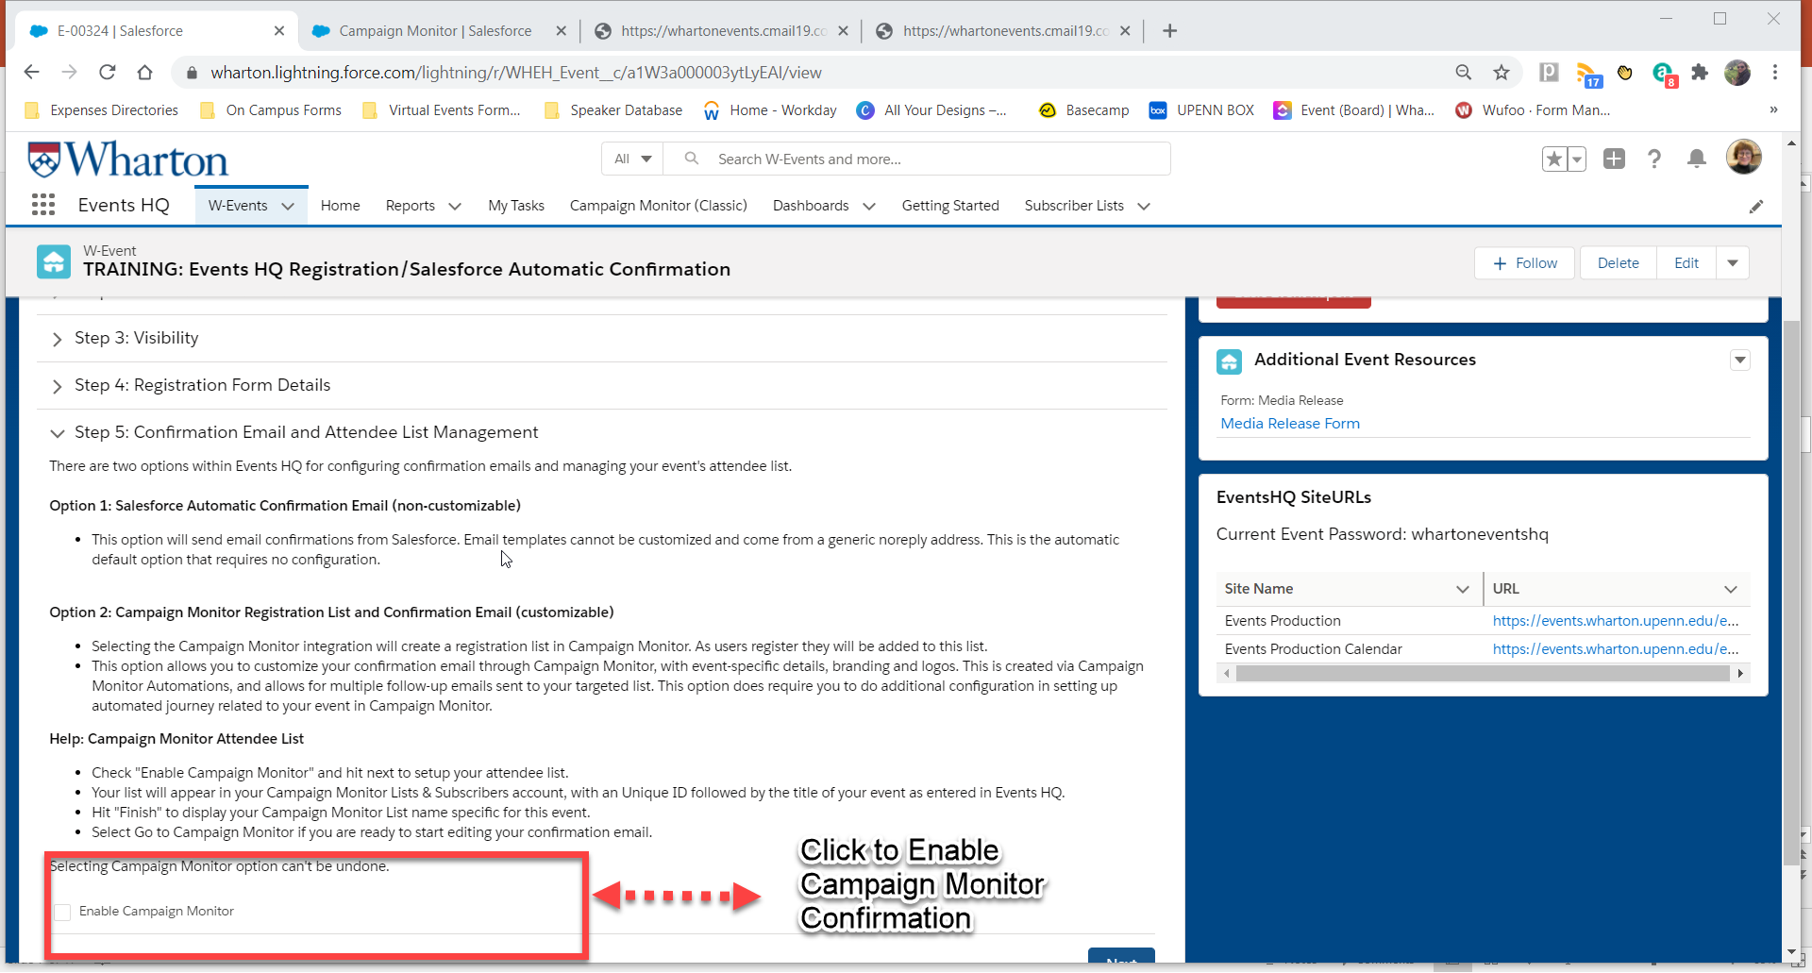
Campaign Monitor Confirmation
Enable in Events HQ by clicking the “Enable Campaign Monitor” checkbox
This allows Events HQ to create a Registered Attendee List directly in your Campaign Monitor Lists and Subscribers tab
This also auto generates “Add to Calendar” hyperlinks (user-specific)

Slide 9
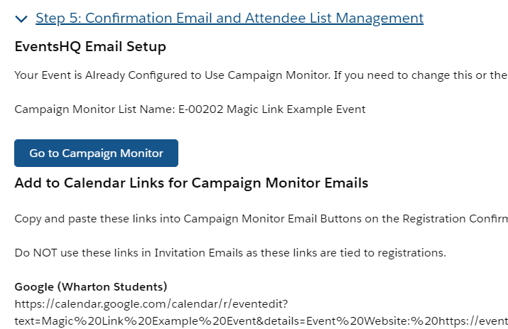
Campaign Monitor Confirmation
Enabling Campaign Monitor
Events HQ
After enabling, hit “Next” and then refresh the page
The name of your new Registered Attendees email list that was created in your Campaign Monitor account will appear in Events HQ for your reference
Campaign Monitor
View your CM Registered Attendees list under “Lists and subscribers” in your CM account

Slide 10
Part 2: Communicating with Attendees with Campaign Monitor
Breaking down the WHAT, WHEN, and HOW of sharing your event details

Slide 11
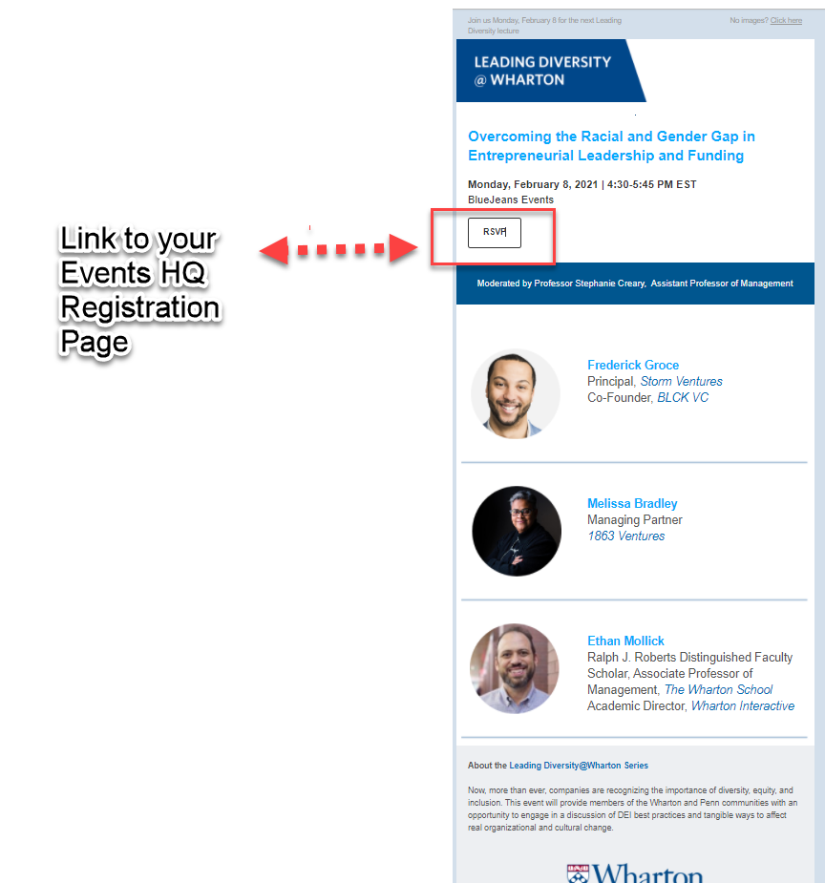
Event Communication Emails
Invitation
Basic information about your event
Links to Events HQ Page for registration
Created through Campaign Monitor –
CAMPAIGNS tab
Tips
Avoid “tech” details on this piece such as event access details
Save event-specific access information for confirmation and reminders

Slide 12
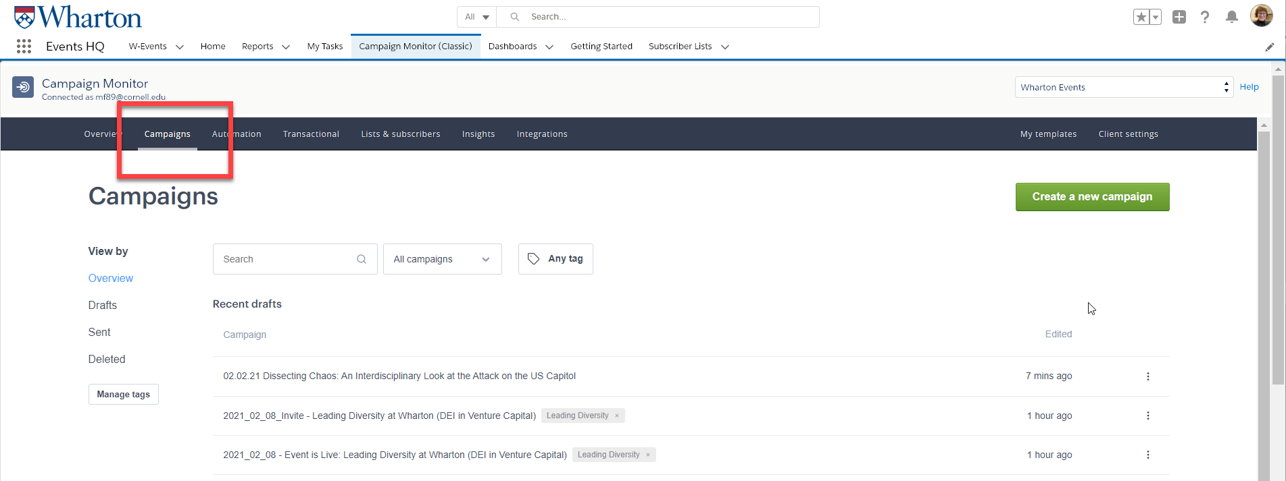
Event Communication Emails
Invitation Set Up
Set up through the CAMPAIGNS tab of your campaign monitor account
Insert the Event Production link for you Events HQ site in the RSVP field of your invitation

Slide 13
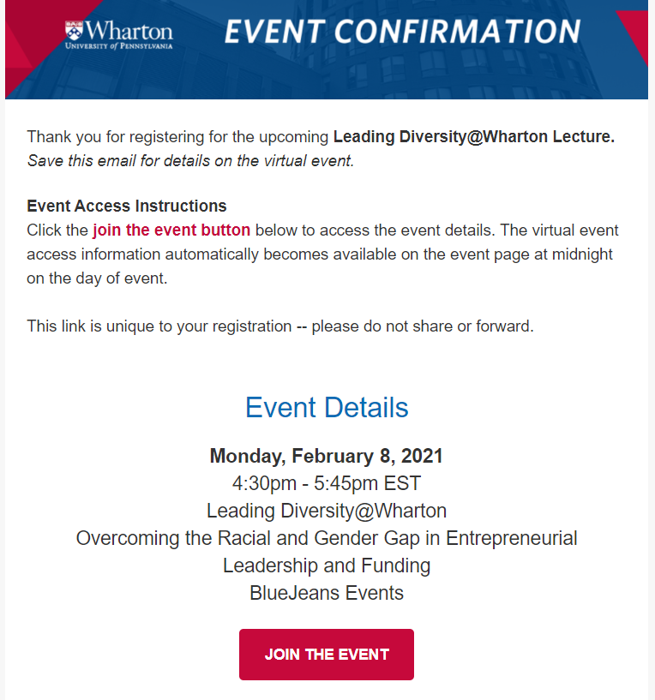
Event Communication Emails
Confirmation
Sent to Registered Attendees
Enable Campaign Monitor when setting up EventsHQ to automatically create registered attendees list in your CM account
Includes your instructions on HOW users will access the event
Use the Join the Event dynamic code – users can click the button to view their confirmation page prior to the event/view the event link on the event date. *This code is universal for all virtual Events HQ events – simply copy and past into any email that brings the user back to the confirmation page. See end of presentation for a detailed explanation.
Created through Campaign Monitor Automations tab
Dynamic Code (universal for all Events HQ events)
https://events.wharton.upenn.edu/events-hq/[EventId,fallback=]/join/?ticket-id=[RegistrationID,fallback=]

Slide 14
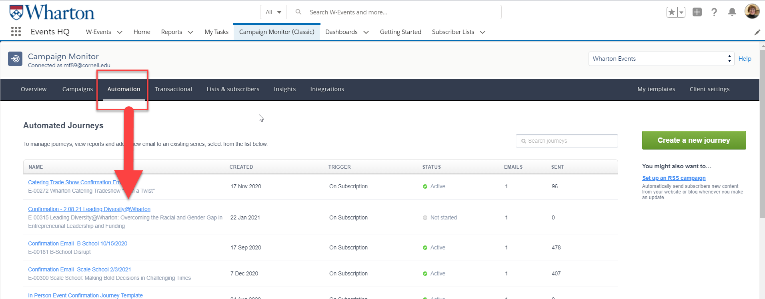
Event Communication Emails
Confirmation Set Up
Set up through the AUTOMATION tab of your campaign monitor account
Email whartonevents@wharton.upenn.edu if AUTOMATIONS does not appear on your account

Slide 15
Event Communication Emails
Confirmation Set Up
Step 1: Create a new journey – select Build your Journey

Slide 16
Event Communication Emails
Confirmation Set Up
Step 2: Name your automation and select your list

Slide 17
Event Communication Emails
Confirmation Set Up
Step 3: Select the “PLUS” sign, and add Email

Slide 18
Event Communication Emails
Confirmation Set Up
Step 4: Add your email sender details

Slide 19
Event Communication Emails
Confirmation Set Up
Step 5: Scroll down and select Add Email content

Slide 20
Event Communication Emails
Confirmation Set Up
Step 6: Select your email template (from recently used or templates).
Edit your content as you would in any other Campaign Monitor Email.
Hit Preview then save

Slide 21
Event Communication Emails
Confirmation Set Up
Step 7: Hit Save & return to journey

Slide 22
Event Communication Emails
Confirmation Set Up
Step 8: Turn on journey to start the confirmation automation

Slide 23
Event Communication Emails
Confirmation Set Up
Return to your automation and view journey activity any time by selecting View Full Report to see how many confirmations were sent, opened, bounced back, etc.

Slide 24
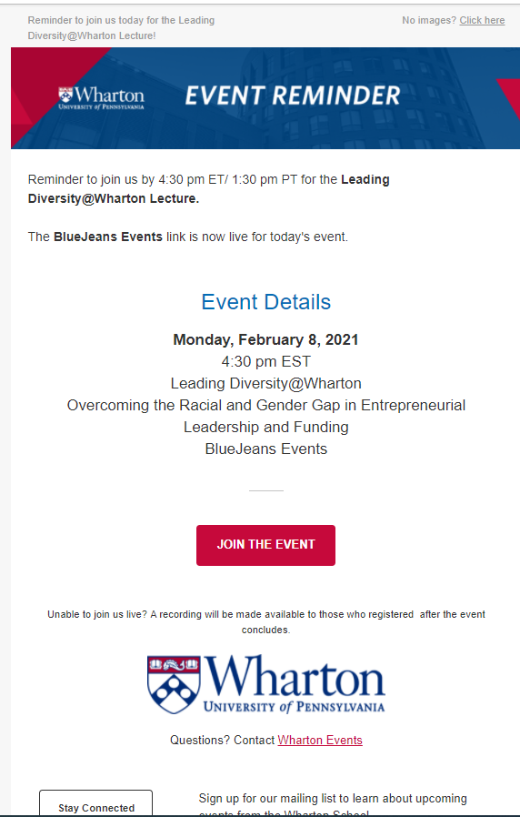
Event Communication Emails
Reminder
Sent to registered attendees (same list from Confirmation email)
Includes reminder instructions on HOW users will access the event
Use the Join the Event code – users can click the button to view the confirmation page prior to the event/view the event link on the event date
Schedule to go out to your registration list – recommendation is 7 days out and 1 day out for virtual events, based on when your original invite was sent
Created through CAMPAIGNS tab

Slide 25
Event Communication Emails
Event is Live
Sent to registered attendees the day of your event
Reminds them to join now
Use the Join the Event code – users can click the button and go directly to the EventsHQ link page
Schedule to go out to your registration list 30 minutes prior to your start time

Slide 26
Part 3: Virtual Access/Join the Event Code
How to set up Virtual Registration in EventsHQ and Campaign Monitor

Slide 27
Virtual Registration – Attendee Virtual Access
Step 3: Set up Join the Event code in your attendee emails
To link your EventsHQ event, Campaign Monitor Registration and Virtual Access Details, use this code on any button/hyperlink where you ask registered attendees to View their Confirmation or Join the Event
..BUT WHY?
Simplify your event setup – code never changes! Just update your email templates for each Event
Keep your event link private
Ensure easy access to event link to registered attendees
Send invite before platform established/change link if needed
Track users from invite through attendance
JOIN THE EVENT CODE
https://events.wharton.upenn.edu/events-hq/[EventId,fallback=]/join/?ticket-id=[RegistrationID,fallback=]
Event ID connects the EventsHQ page
Registration ID confirms the users registration
JOIN shares the private link & marks the user as attendee

Slide 28
Virtual Registration – Attendee Virtual Access
EVENT DAY – MARKED AS ATTENDANCE
After your event, users who clicked the Join the Event button are automatically marked as attendance in you EventsHQ registration
This means you can track:
Who was sent invite
Who opened/clicked/registered for invite
Who attended the event

Slide 29
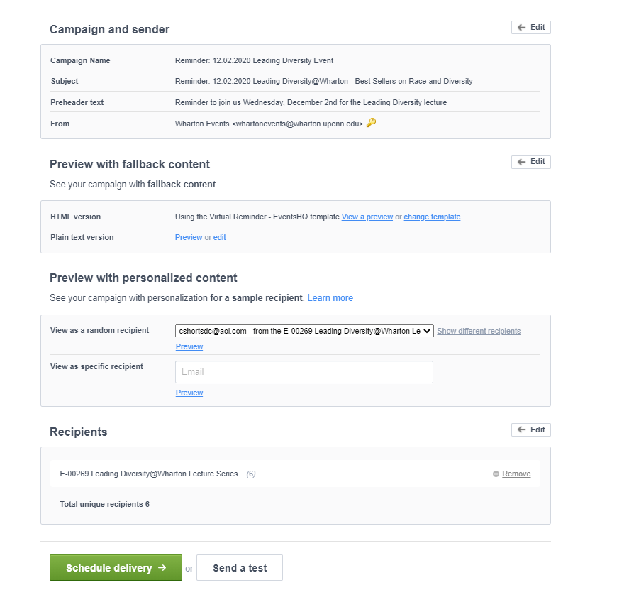
Previewing Confirmation/Reminder Links
Unlike your invites or traditional Campaign Monitored emails, the content in each of your virtual confirmation/reminder emails is unique to the specific recipient. You will not be able to preview the email content through sending a test – a 404/Error message will appear
To preview that the dynamic link is displaying correcting for your users, you need to define your recipients to the email.
Select the list created by Events HQ, begins with E-XXXXX
Select Preview with personalized content, then click Preview
Join the Event button on the preview email that appears should now correctly display.
PREVIEW WITH PERSONALIZED CONTENT
DEFINE RECIPIENT – REMINDER EMAIL

