Slide 1
EventsHQ
Virtual Event Registration
Marketing Communications Office \ updated November 2020

Slide 2
Part 1: What the User Sees
Virtual Event Details & Join the Event link

Slide 3
Virtual Registration – User View
Thanks for choosing Events HQ for your virtual event. If you are using Events HQ for your registration and confirmation, there are a few options to consider for how you share your virtual event access link (whether that is BlueJeans, Zoom, YouTube, etc) with your audience.
OPTION 1 Events HQ Virtual Platform Access -Virtual platform details [Zoom, Blue Jeans links] entered in Events HQ Virtual Details box - Link remains private until event day using Virtual Confirmation & Event Page link sent via the confirmation email - Link accessible only to registered attendees.
OPTION 2 Directly share virtual platform link -Include your access link on your Event Page or in your confirmation email

Slide 4
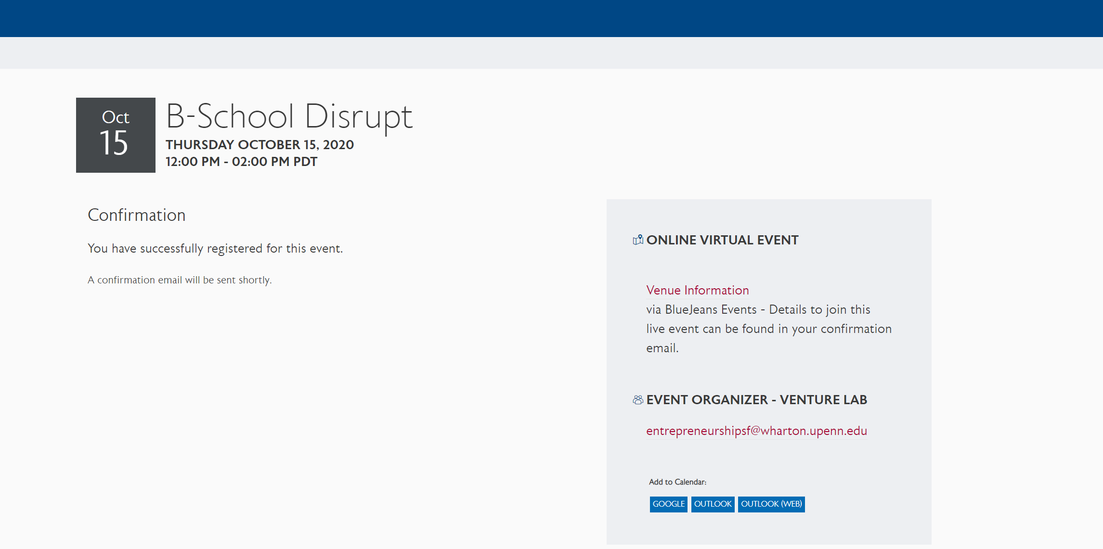
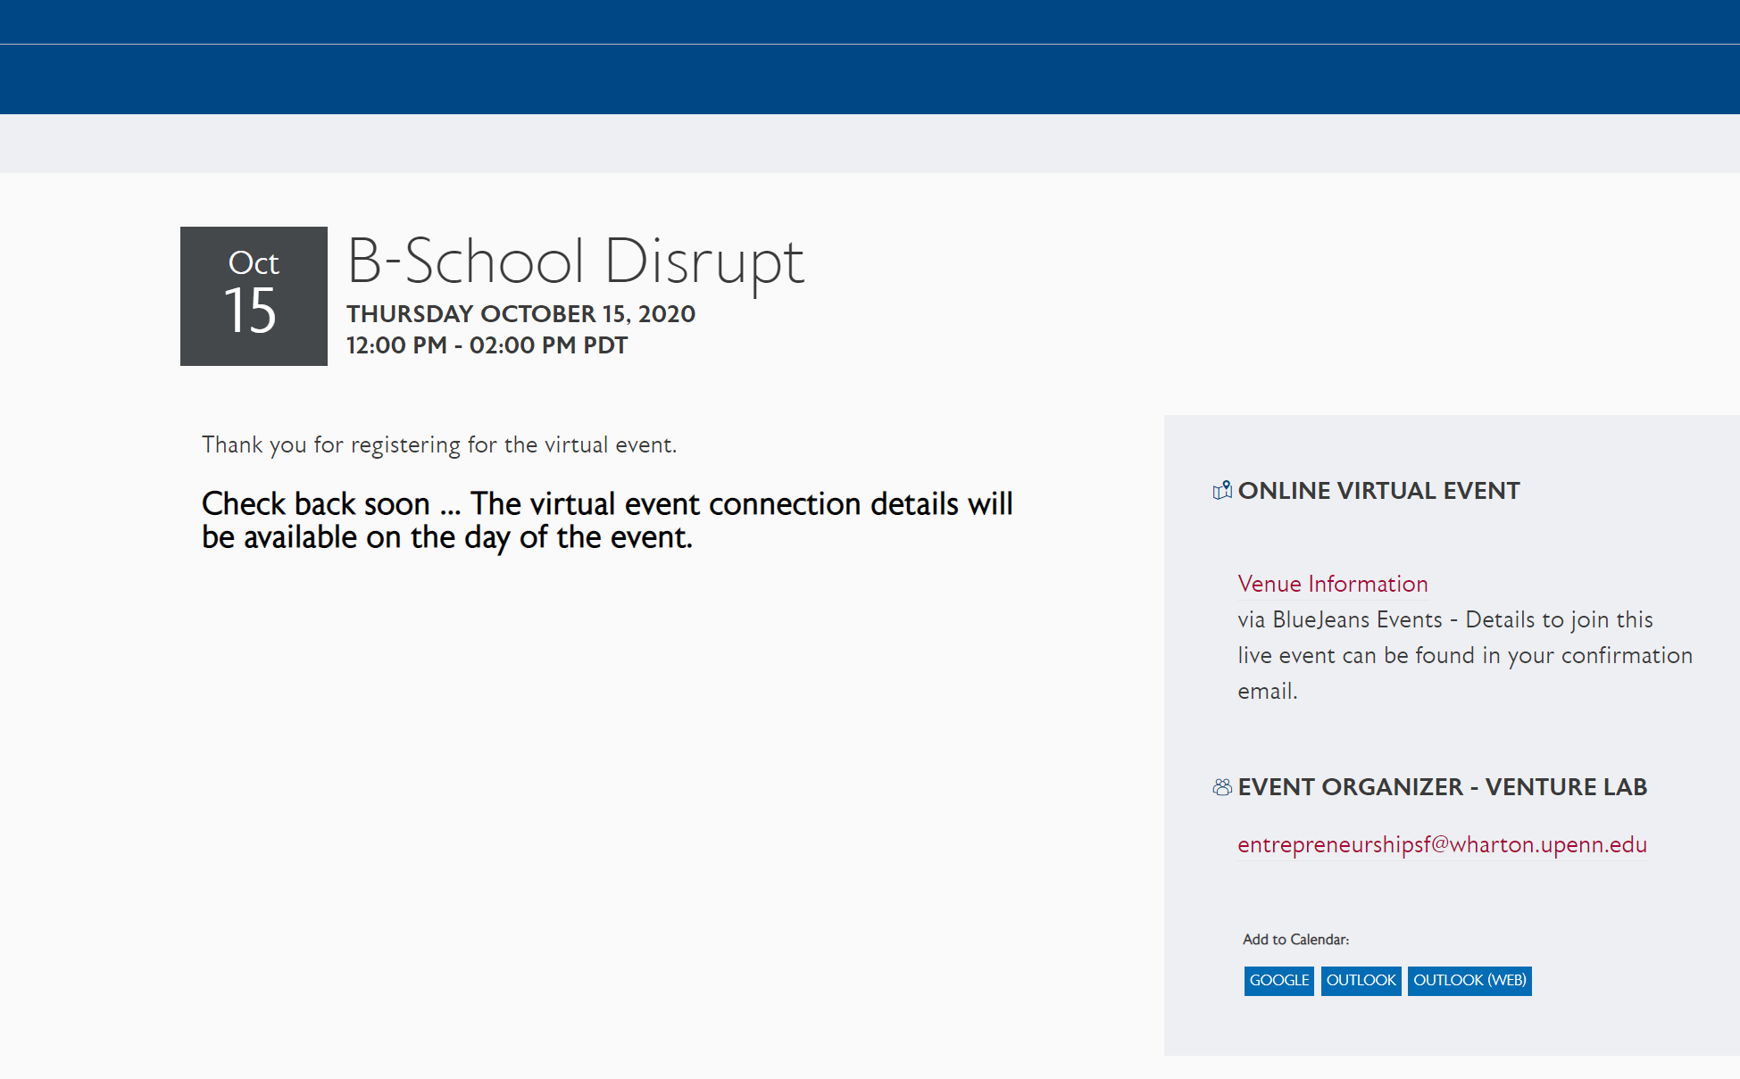
Virtual Registration – User View
When using the Virtual Event Details feature of EventsHQ, your link is hidden until your event day (at midnight). So the user sees the following:
At Confirmation
Message confirms registration. Link sent via confirmation
After Confirmation
Holding message displays until 48 hours prior event date with user clicks Confirmation & Event Access link

Slide 5
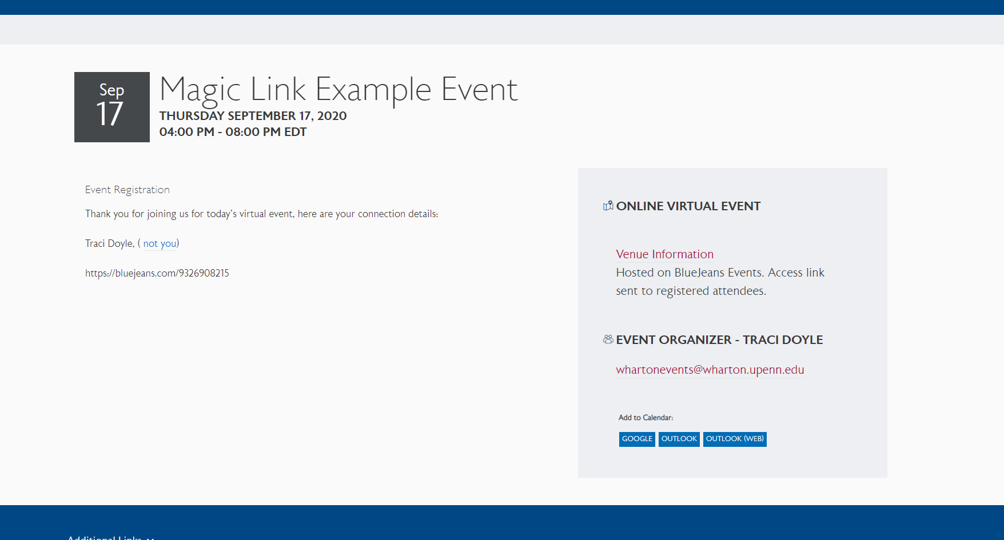
Virtual Registration – User View
EVENT DAY On the day of the event, the user clicks the Confirmation & Event Access link from your email confirmation. The access information from the Events HQ Virtual Details section appears
Best practice:
Send a 30 minute Reminder/Event is Live Email that includes the Virtual Confirmation Link
Hyperlink your virtual access link when entering in Events HQ

Slide 6
Part 2: Virtual Event Set Up - Generic Confirmation Email
How to set up Virtual Registration in Events HQ with a generic confirmation email

Slide 7
Events HQ – Virtual Events w/Generic Confirmation
Step 1: Add Zoom Link to Events HQ
The connection details to view your virtual event should be entered in the Virtual Event Details section of EventsHQ
Add the virtual event link up to (2) days prior to your event - Great if you have not determined your platform when the invite goes out, or last minute changes from Zoom Meetings to Zoom Webinar.
Virtual Event Details displayed only to registered users staring 48 hours prior to event date
By clicking the Confirmation & Event Access link to join the event, registered users are automatically marked at Attended in your registration list.

Slide 8
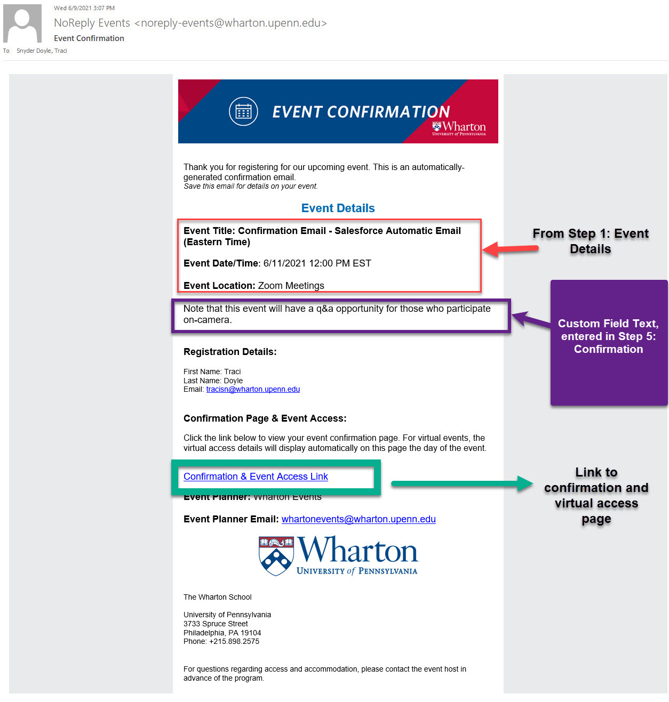
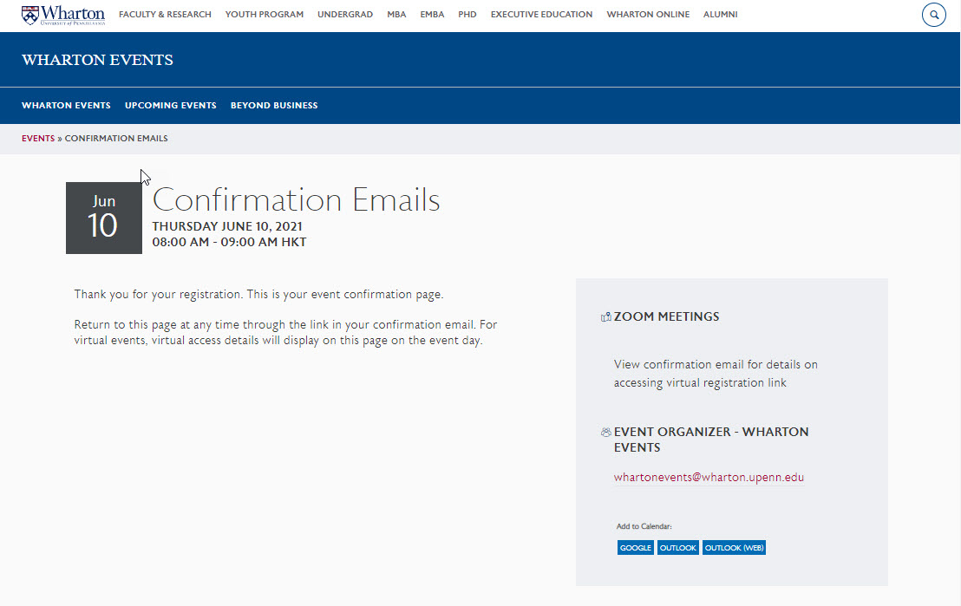
Events HQ – Virtual Events w/Generic Confirmation
Step 2: Generic Confirmation Email
When using the Salesforce Automatic Confirmation Email, the Confirmation & Event Access link is automatically generated and sent to your registered attendees. No additional steps are necessary. When a registered attendee clicks the Confirmation & Event Access link from their confirmation email, they will be brought to a page revealing the private Zoom/Blue Jeans links that you entered in the Virtual Details field.

Slide 9
Part 3: Virtual Event Set Up - Custom Confirmation Email
How to set up Virtual Registration and send custom Confirmation & Reminder emails using Campaign Monitor

Slide 10
Events HQ – Virtual Events w/Custom Confirmation
Step 1: Add Zoom Link to Events HQ
The connection details to view your virtual event should be entered in the Virtual Event Details section of EventsHQ
Add the virtual event link up to (2) days prior to your event - Great if you have not determined your platform when the invite goes out, or last minute changes from Zoom Meetings to Zoom Webinar.
Virtual Event Details displayed only to registered users staring 48 hours prior to event date
By clicking the Confirmation & Event Access link to join the event, registered users are automatically marked at Attended in your registration list.

Slide 11
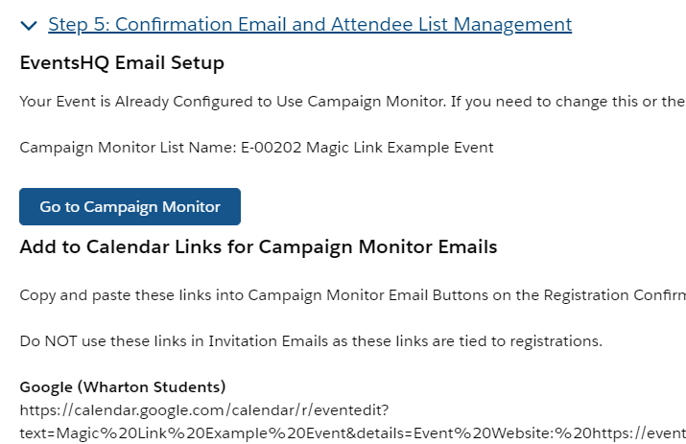
Events HQ – Virtual Events w/Custom Confirmation
Step 2: Enable Campaign Monitor in Events HQ
EventsHQ
Creates a registration list in CM for your event
Campaign Monitor
View your CM Registration List

Slide 12
Events HQ – Virtual Events w/Custom Confirmation
Step 3: Add the Virtual Confirmation Link to your custom emails
To link your Events HQ event, Campaign Monitor Registration and Virtual Access Details, use this virtual confirmation link on any button/hyperlink where you ask registered attendees to View their Confirmation or Join the Event. This is a universal dynamic link for all users.
..BUT WHY?
Simplify your event setup – code never changes! Just update your email templates for each Event
Keep your event link private
Ensure easy access to event link to reg. attendees
Send invite before platform established/change link if needed
Track users from invite through attendance
VIRTUAL CONFIRMATION LINK
https://events.wharton.upenn.edu/events-hq/[EventId,fallback=]/join/?ticket-id=[RegistrationID,fallback=]
Event ID connects the EventsHQ page
Registration ID confirms the users registration
JOIN shares the private link & marks the user as attendee

Slide 13
Events HQ – Virtual Events w/Custom Confirmation
VIRTUAL CONFIRMATION LINK – WHERE, WHY, HOW?
CONFIRMATION
REMINDER
EVENT IS LIVE
Enable Campaign Monitor during your EventsHQ setup – creates Registration List.
Create a confirmation journey to send to the Registration List.
Add a button in your confirmation email and enter the virtual confirmation link as the hyperlink
When registered user clicks, brings them to Event Confirmation page
Same code from confirmation
Schedule a Reminder email in Campaign Monitor
Sent to the registration list created through EventsHQ
When registered user clicks, brings them to Event Confirmation Page
Same code as confirmation, reminder email
Schedule an Event is Live email in Campaign Monitor
Email sent to the same registration list
When registered user clicks on the event day, brings them to page with Virtual Access Link visible

Slide 14
Events HQ – Virtual Events w/Custom Confirmation
EVENT DAY – MARKED AS ATTENDED
After your event, users who clicked the Virtual Confirmation Link are automatically marked as attendance in you EventsHQ registration
This means you can track:
Who was sent invite
Who opened/clicked/registered for invite
Who attended the event

Slide 15
Part 4: Communicating with Attendees
Recommendations on sharing virtual event details with your registered attendees

Slide 16
Virtual Events - Communications
There are a number of key details that need to be shared with your audience for virtual events. We created a series of Campaign Monitor templates to help streamline this process.
7-10 DAYS OUT
INVITE
AUTOMATE
CONFIM
1-2 DAYS OUT
REMIND
30 MINUTES
JOIN NOW

Slide 17
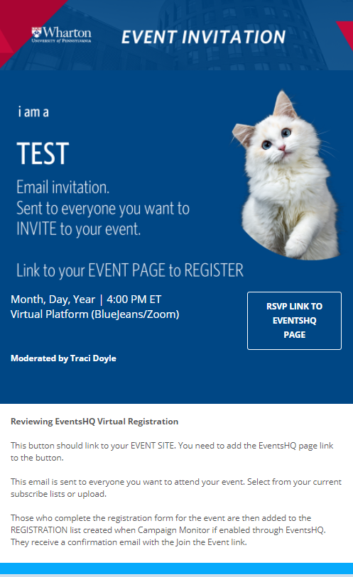
Virtual Event Communication Pieces
Invitation
Basic information about your event
Links to Events HQ Page for registration
Avoid “tech” details on this piece such as event access details
– save that for confirmation

Slide 18
Virtual Event Communication Pieces
Confirmation - Generic
Sent to registered attendees
Enter any custom message you want to included under Step 5: Confirmation
Automatically includes Confirmation & Event Access link [same code as the virtual confirmation link]

Slide 19
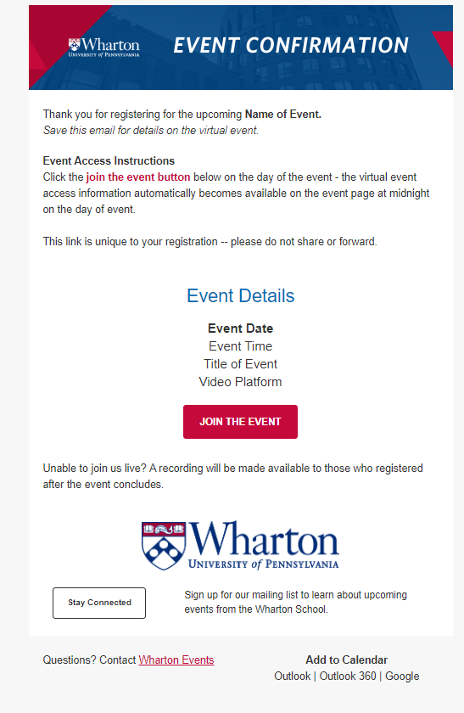
Virtual Event Communication Pieces
Confirmation - Custom
Sent to registered attendees
Enable Campaign Monitor when setting up EventsHQ to automatically create list in your CM account
Includes your instructions on HOW users will access the event
Use the Virtual Confirmation Link – users can click the button to view the confirmation page prior to the event/view the event link on the event date
Create an automation through Campaign Monitor to send automatically.

Slide 20
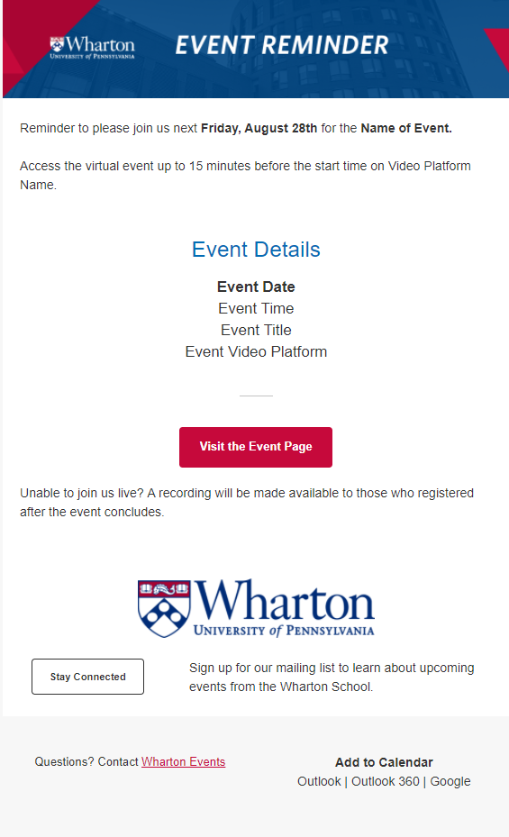
Virtual Event Communication Pieces
Reminder - Custom
Sent to registered attendees
Includes reminder instructions on HOW users will access the event
Use the Join the Event code – users can click the button to view the confirmation page prior to the event/view the event link on the event date
Schedule to go out to your registration list – recommendation is 7 days out and 1 day out for virtual events, based on when your original invite was sent

Slide 21
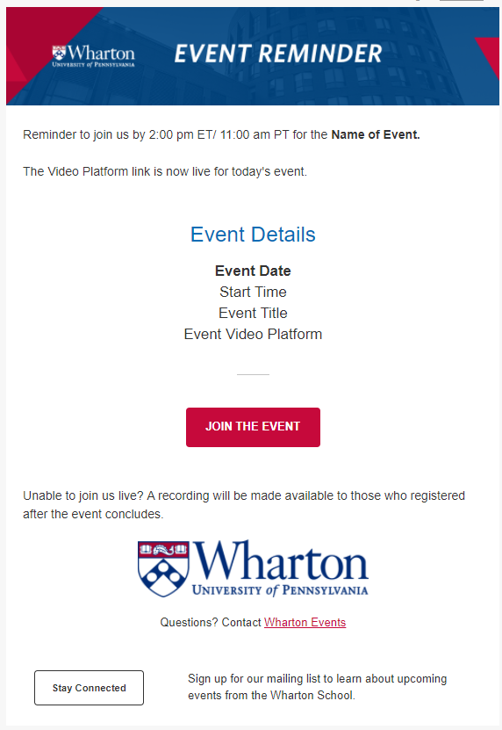
Virtual Event Communication Pieces
Event is Live - Custom
Sent to registered attendees the day of your event
Reminds them to join now
Use the Join the Event code – users can click the button and go directly to the EventsHQ link page
Schedule to go out to your registration list 30 minutes prior to your start time

Slide 22
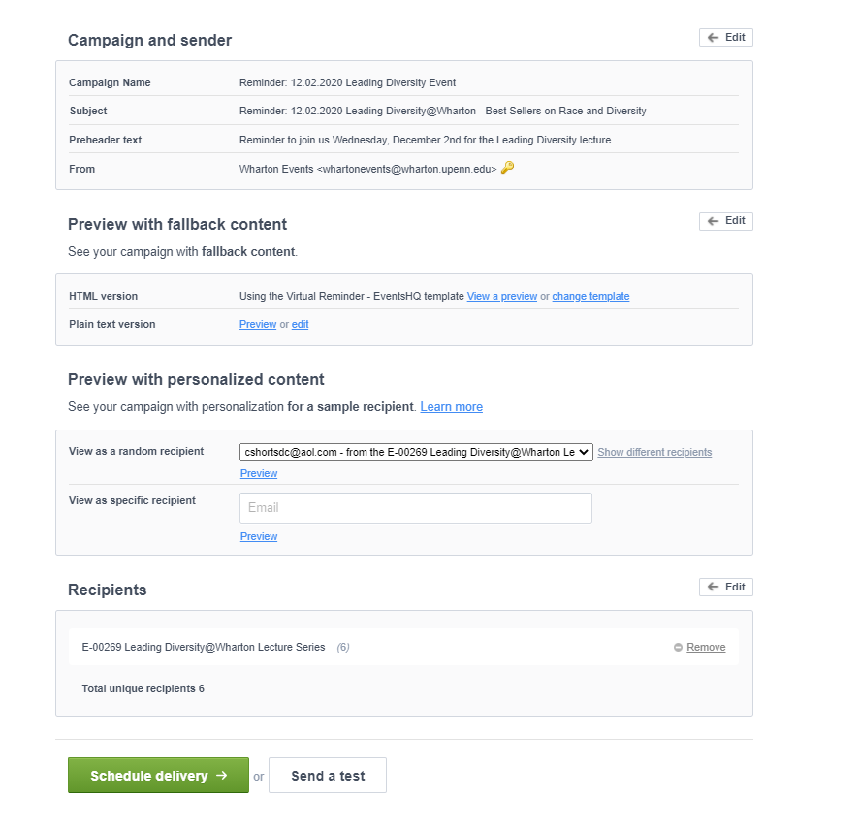
Previewing Confirmation/Reminder Links
To preview that the dynamic link is displaying correcting for your users, simply define your recipients (Select the list created by Events HQ, begins with E-) and select preview with dynamic content
DEFINE RECIPIENT
PREVIEW WITH PERSONALIZED CONTENT
Select Preview with personalized content, then click the Join the Event button on the preview email that appears.

